Slide 1
Seminar 9
14th Jul 2016, Tran Viet Cuong

Slide 2
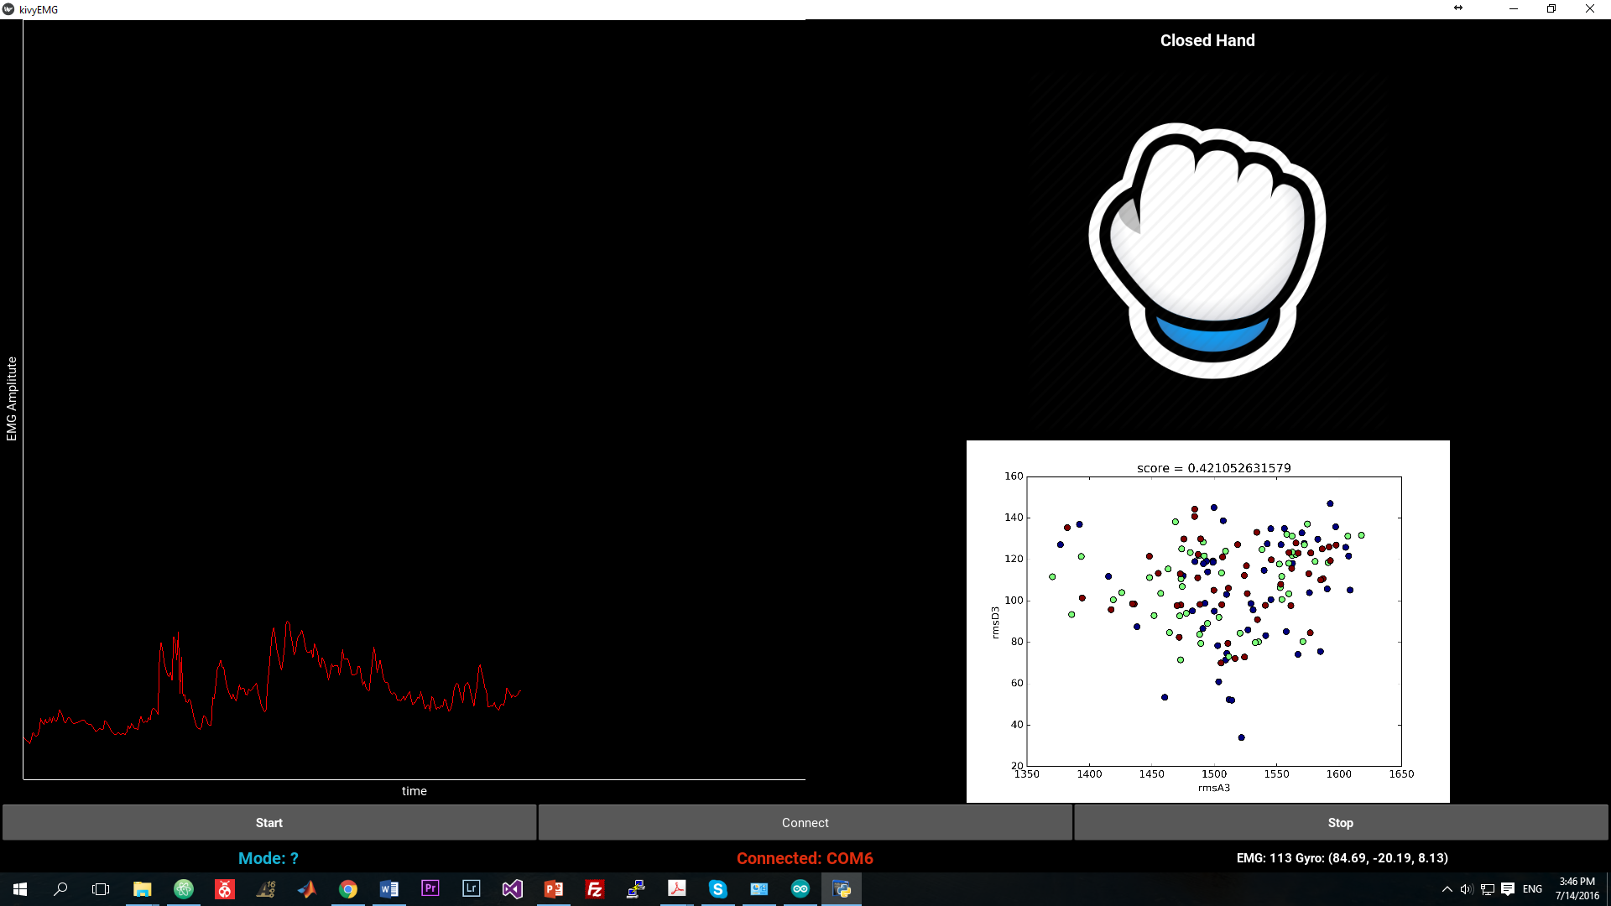
Algorithm and GUI for hand gestures recognition

Slide 3
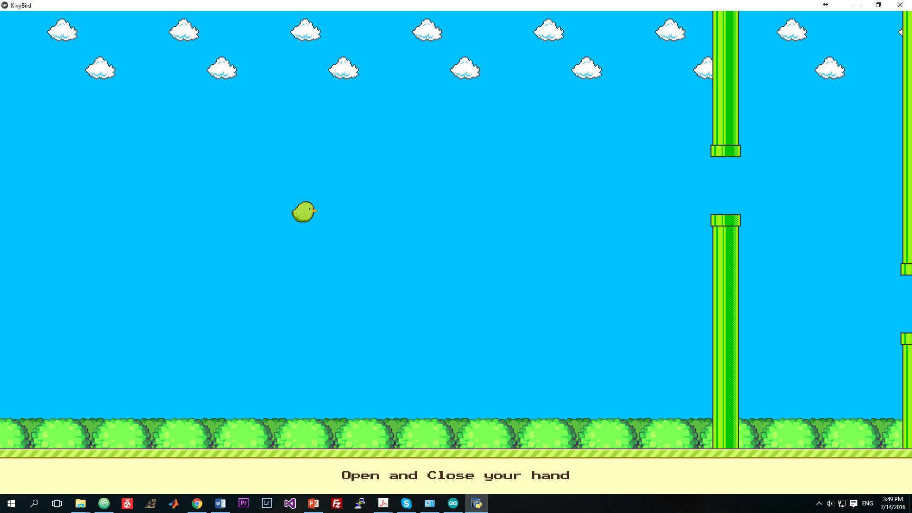
Game Flappy Bird and App for Wins

Slide 4
EMG
The place that attach your electrodes
The features
How many channels
The connection from EMG sensors to MCU
The parameters of model that you choose

Slide 5
Python + kivy
Cross platform
Apply Machine Learning

Slide 6
Next 2 weeks:
Dry Electrodes
Find the way that makes the accuracy more higher

Slide 7
Thank you!!!

Slide 8
Question??

